Slide 1
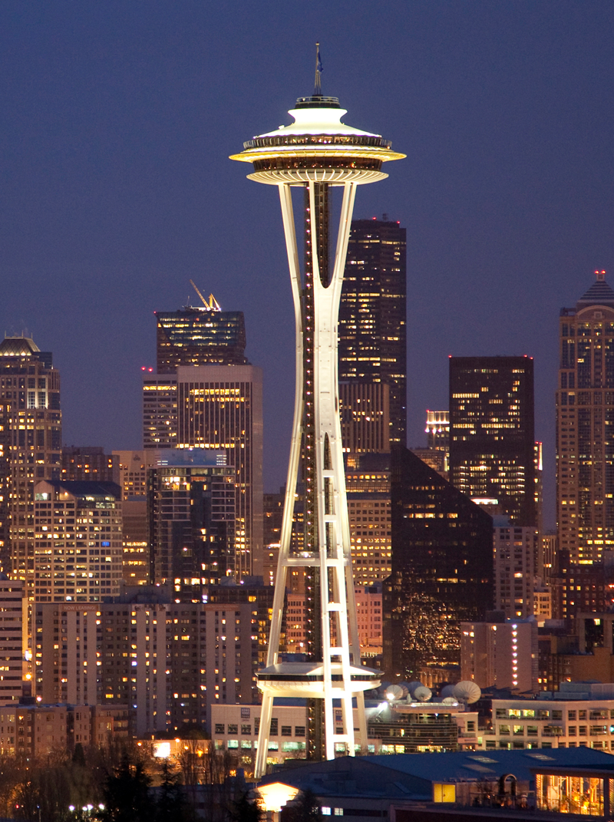
Car accident severity in Seattle
(2004-2020)
Caption
Coursera capstone project
Cesar Garcia - Oct 2020
Miami

Slide 2
Abstract
According to the National Safety Council (nsc.org) during 2019 and 2018 the US experience a decline in the number of roadway deaths. It is estimated in 2019 approximately 38,000 people lost their lives due to car crashes. Even though this decline is encouraging the total of people seriously injured in 2019 were 4.4 million. This numbers shows why traffic accidents are an important public safety challenge.
This explains why information is needed in order to guide local and national governments in what are the driving factors and how to prevent car accidents and fatalities.
We believe that using data and the proper analysis we can create prediction models.
Once a solid model is developed we may be able to apply it to different cities and countries, not only US.

Slide 3
Data
Two main data sources:
Data_Collision, a CSV file provided by the Coursera web site. This is an extract of the data provided by the City of Seattle with a full record of all car accidents in the city, with more than 30 different attributes and expanding from 2004 to the first months of 2020; created using ArcGIS. https://s3.us.cloud-object-storage.appdomain.cloud/cf-courses-data/CognitiveClass/DP0701EN/version-2/Data-Collisions.csv
City_Clerk_Neighborhoods.geojson: Geographical data provided by the City of Seattle with the boundaries of all the neighborhoods in the city. https://data.seattle.gov/dataset/Municipal-Boundaries/54dn-ah5p

Slide 4
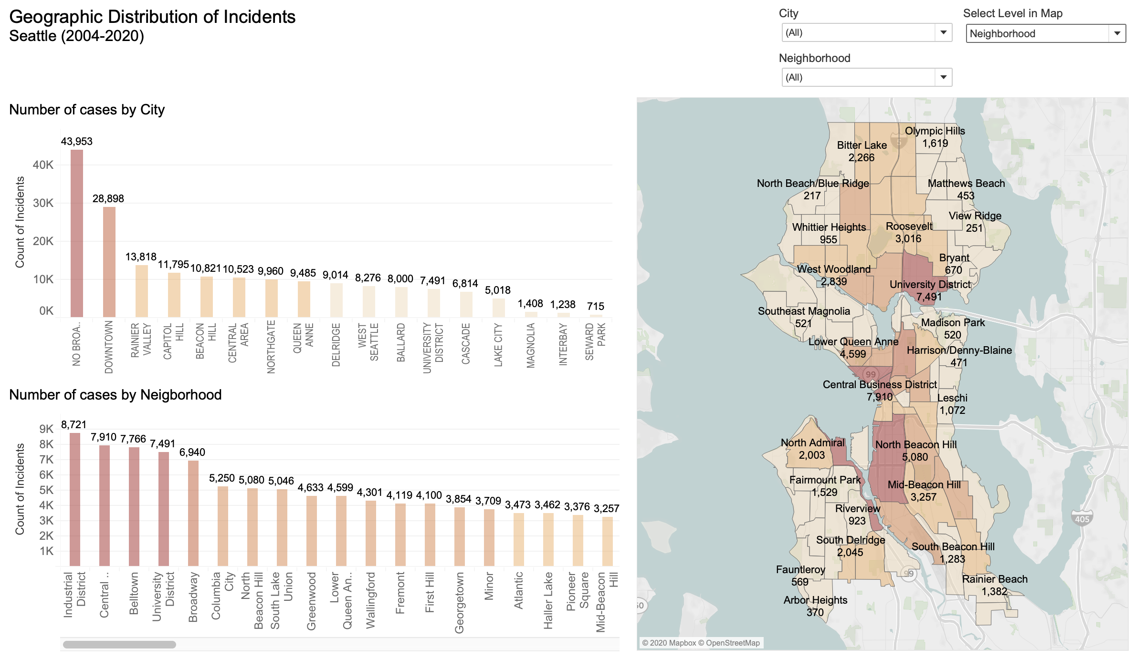
Visual Exploration
Neighborhood at risk
The neighborhoods with the most accidents are:
Industrial District
Central Business District
Belltown
University District
Caption

Slide 5
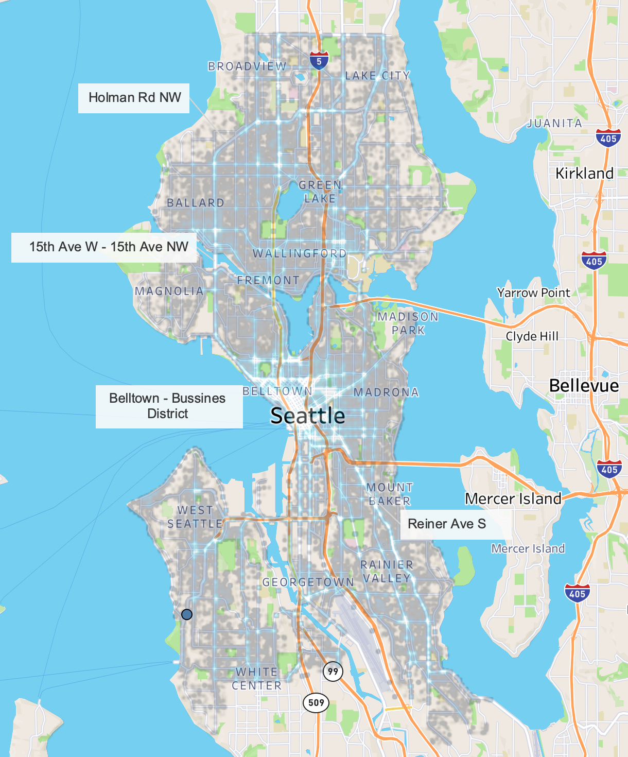
Dangerous Roads
In the south of the city there are a lot of incidents in Reiner Ave S, even though this is not a highway.
In the north of the city north west of Belltown, 15th Ave W and 15th Ave NW all the way to Holman Rd NW there are a lot of incidents.
All those are roads, not highways, but they show a lot of incidents.
Caption

Slide 6
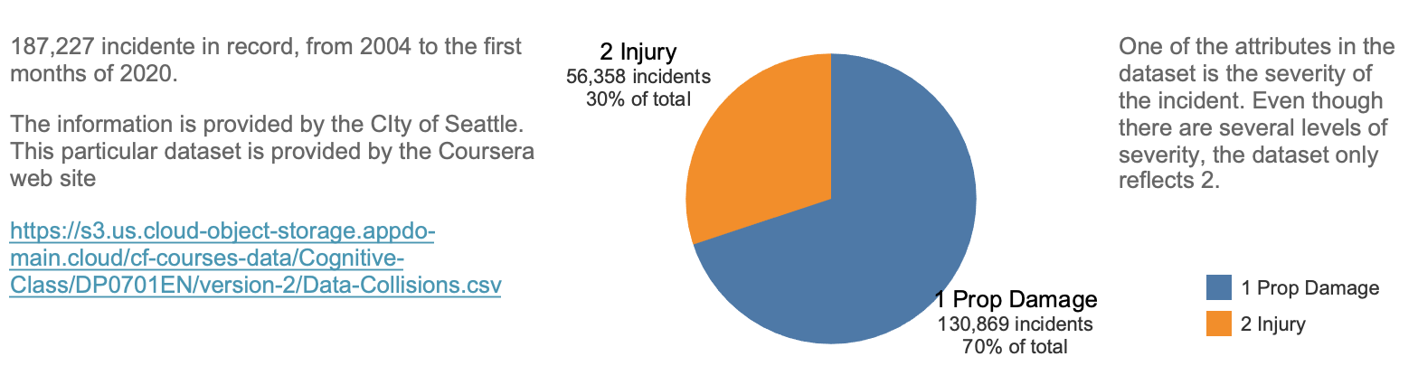
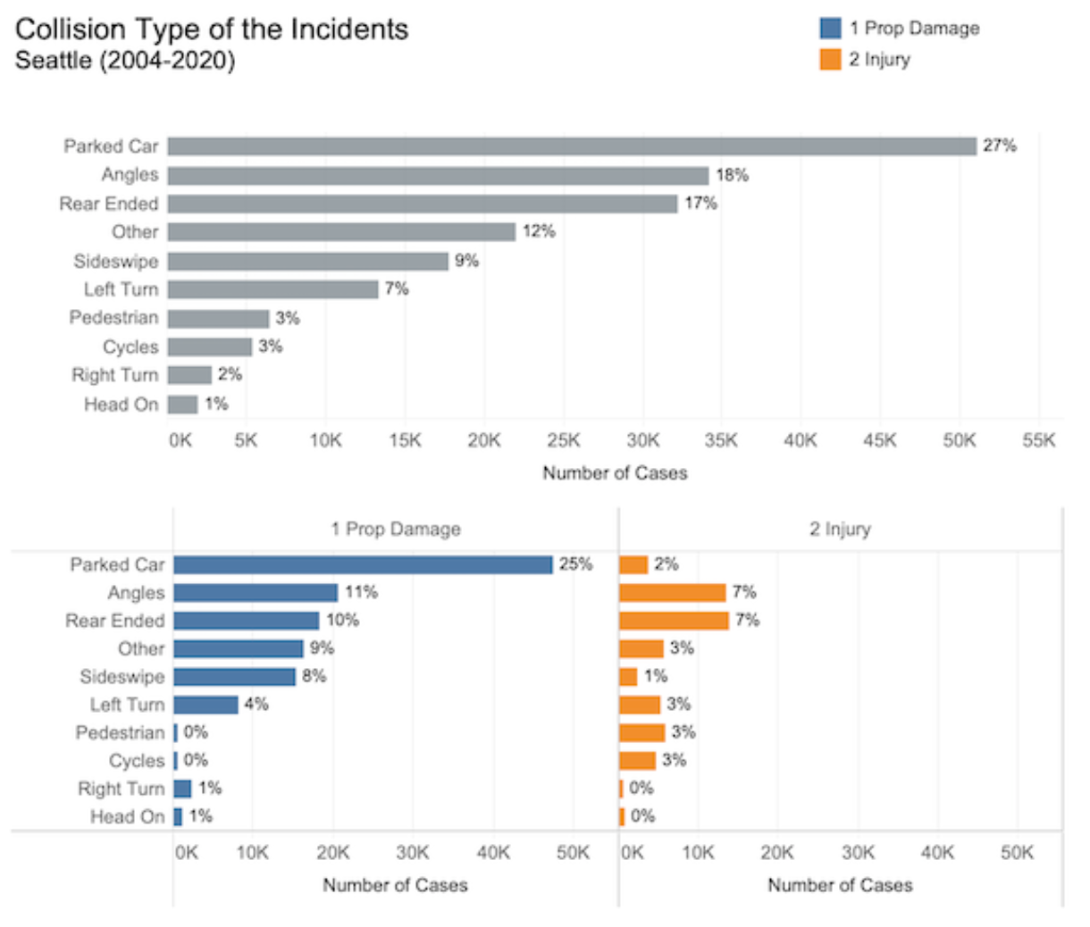
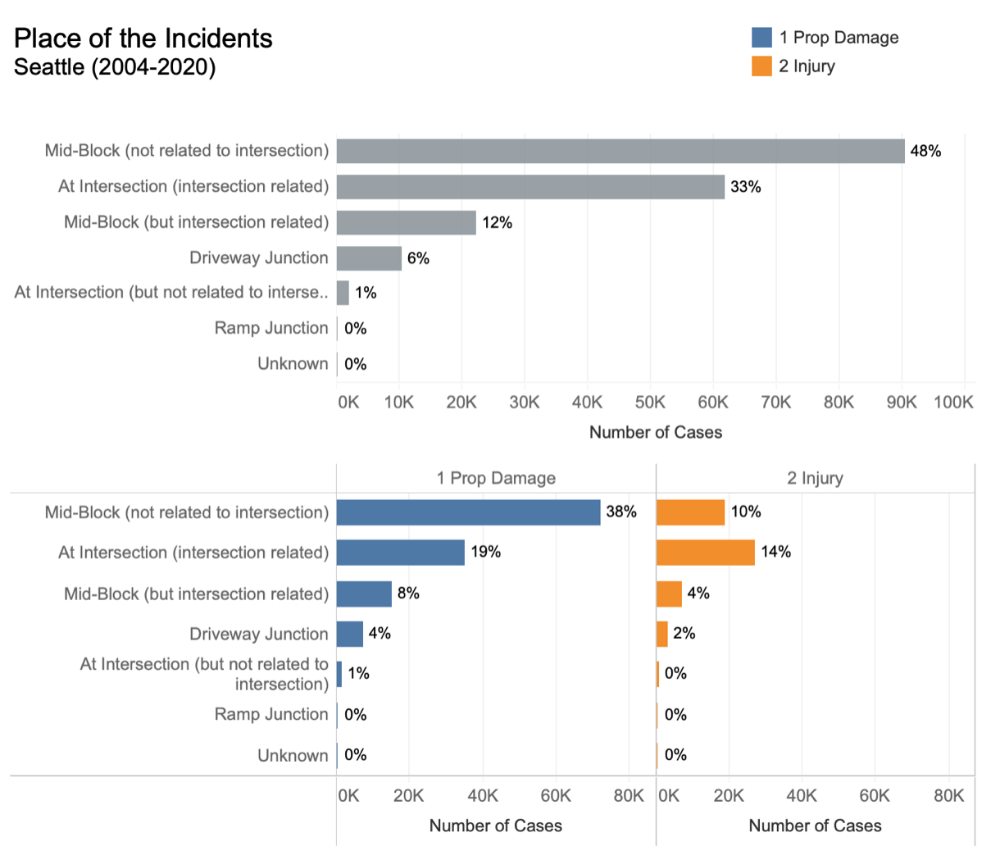
How are the
accidents classified

Slide 7
Methodology
The information provided by the City of Seattle is plenty but several attributes are correlated, incomplete, or not significant.
For this research the dependent variable will be Severity Code, a categorical value.
The independent variables will be Collision Type, Address Type, Junction Type, Latitude and Longitude.
We will focus on identify problematic areas and within those create clusters of locations, (using **K-mean** -ns clustering) and Logistic regression with related attributes that help the stakeholder identify problems and spark conversations for possible solutions.

Slide 8
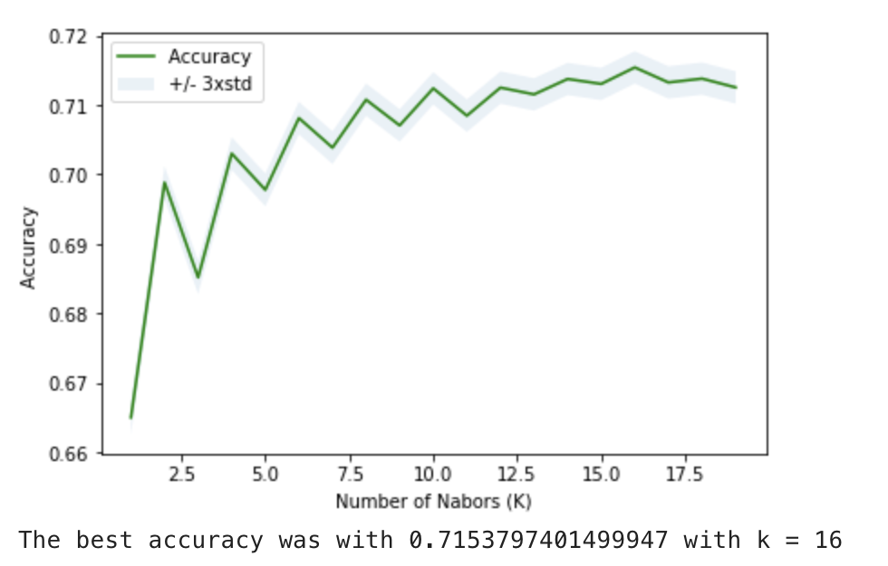
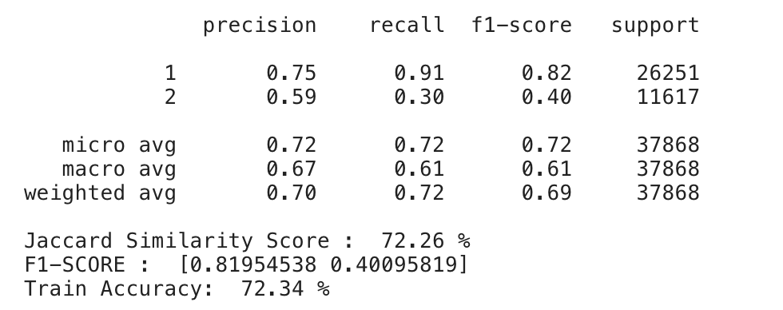
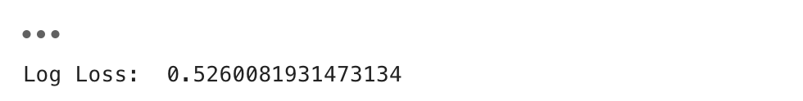
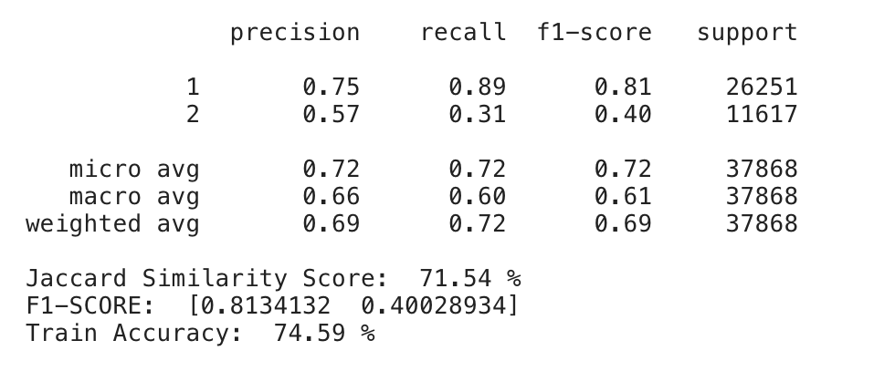
KNN
Logistic Regression

Slide 9
Results and Discussions
Our visual analysis helped identify the four neighborhood with more incidents (Industrial District, Central Business District, Belltown and University District) as well as two roads with high density of accidents; Reiner Ave S and the stretch from 15th Ave W to 15th Ave NW all the way to Holman Rd NW.
WEATHER, ROAD CONDITIONS and LIGHT CONDITIONS were not are not significant factors in the number of accidents. SPEED also has little incident in the total number of accidents.
The three more common kind of collision types are: parked cars, a car hit by the angle or the car being rear ended. This research may need to expand the analysis to determine if, for example, the collision of parked cars has any relation with the location of nearby universities, in the University District, or retail location, in Belltown or the Central Business District.
When evaluated both algorithms presented similar results, with Logistic Regression presenting a slightly better results.

Slide 10
Conclusions
We were able to identify the main neighborhoods that have the highest number of incidents, as well as the 2 roads that accumulate the highest density of accidents.
Some information may be missing or recorded incomplete. SEVERITY CODE only recorded 2 type of collision out of the 4 available, not considering the "unknown" value. Also 16% of the “Incident Timestamp”, time stamp attribute, did not have the time value, only de date. Stakeholder may need to review internal process in order to collect that data.
Both the KNN and Logistic Regression algorithms present similar accuracy with the later being slightly better and also faster to perform.
Collision Type, Address Type, Junction Type, Latitude and Longitude are good predictor of the severity of a car accident.
There is a huge opportunity to expand this research with more detail the geography and transit loads of the city.

